Slide 1

FL_PyTorch Optimization Research Simulator for Federated Learning Konstantin Burlachenko
Notes:
Color theme: https://colorbrewer2.org/?type=diverging&scheme=RdGy&n=9

Slide 2
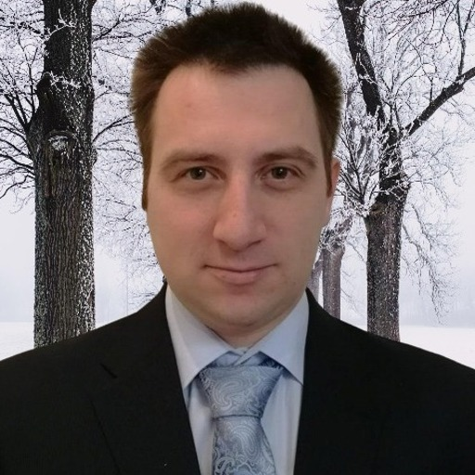
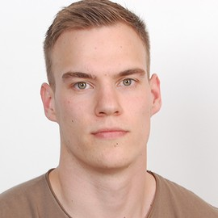
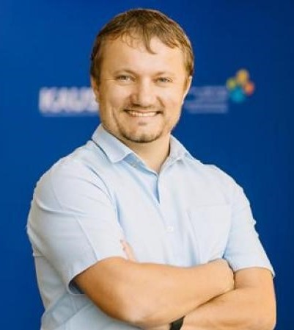
Konstantin Burlachenko
PhD student KAUST
konstantin.burlachenko@kaust.edu.sa
Samuel Horváth
PhD student KAUST
samuel.horvath@kaust.edu.sa
Peter Richtárik Professor of Computer Science KAUST
peter.richtarik@kaust.edu.sa
Notes:
Gentle Introduction into Federated Learning. What is, why it is interesting.
Define in easy way. (Talk about Examples) (30 seconds)

Slide 3
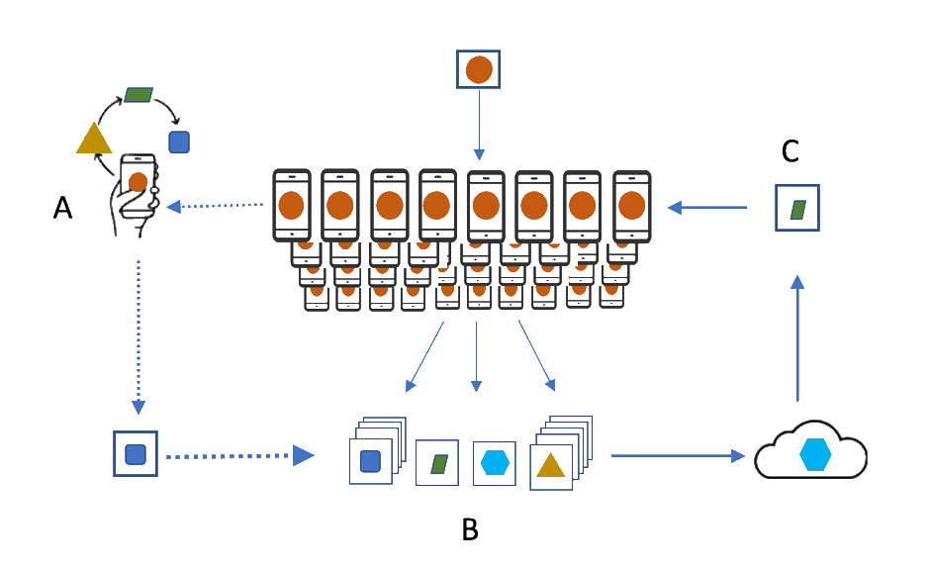
Federated Learning
3
The goal of FL is to find a model deployable on each client while protecting the clients’ data
Some challenges: many devices; privacy; data heterogeneity; communication; partial participation
Notes:
Federated Learning (FL) has emerged as a promising technique to collaboratively learn a shared machine learning model while keeping training data locally on the device.
Aspects of FL:
- Really there are no control over data stored in mobile phone
- Billions of mobile phone users
Another view into client:
Organizations or institutions can play the role of the “devices” in the context of federated learning.
In such a setting, Federated learning can bring enable private learning between various organizations.
Several projects that uses FL:
- Google use it in the Gboard mobile keyboard for applications including next word prediction
- Android Messages
- Apple in iOS 13 for QuickType keyboard.
- Apple uses FL for applications like the QuickType keyboard and the vocal classifier for “Hey Siri”. Due to FL, Apple upgraded Siri to distinguish the person who owns the Phone from other people's voices.
Privacy:
Stronger privacy properties are possible when FL is combined with other technologies such as differential privacy, and secure multiparty computation (SMPC) and there is a direction of research of applying Homomorhic Encryption for FL.
List of startups in FL:
https://www.discreetai.com/ https://doc.ai/ https://www.xain.io/ https://owkin.com/ https://edgedelta.com/ https://springdel.com/ https://symetry.net/ https://fate.fedai.org/ https://github.com/WeBankFinTech/Eggroll https://www.s20.ai/
Many devices. We have n devices (e.g., mobile phones, tablets) with n being huge. Devices memory, compute power is varying.
Privacy. Users do not want to send data to a centralized data center for processing. Clients process the data locally.
Data heterogeneity. Training data varies across users. Data, as a source for training, exists in a lot of places.
Communication. Very expensive in terms of time. It is a part of algorithms developed in the field, not entirely as a part of the infrastructure.
Partial participation. Not all devices are always available to participate in training.
Computation. It is performing in a distributed way.

Slide 4
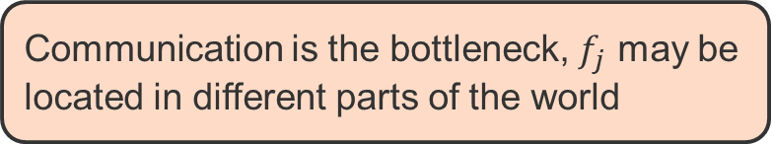
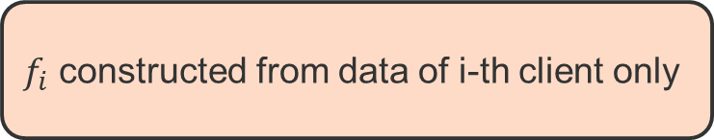
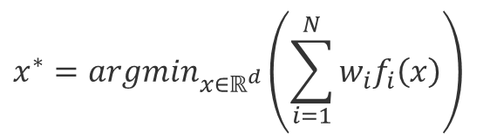
Federated Learning: Classical Objective
4
$$x_{}^{∗}=argmin_{x∈ℝ^{d}}\left(\sum_{i=1}^{N}{w_{i}f_{i}\left(x\right)}\right)$$
Number of clients
(e.g., mobile phones)
$f_{i}$ constructed from data of i-th client only
Communication is the bottleneck, $f_{j}$ may be located in different parts of the world
Notes:
Federated Learning (FL) has emerged as a promising technique to collaboratively learn a shared machine learning model while keeping training data locally on the device.
Aspects of FL:
- Really there are no control over data stored in mobile phone
- Billions of mobile phone users
Another view into client:
Organizations or institutions can play the role of the “devices” in the context of federated learning.
In such a setting, Federated learning can bring enable private learning between various organizations.
Several projects that uses FL:
- Google use it in the Gboard mobile keyboard for applications including next word prediction
- Android Messages
- Apple in iOS 13 for QuickType keyboard.
- Apple uses FL for applications like the QuickType keyboard and the vocal classifier for “Hey Siri”. Due to FL, Apple upgraded Siri to distinguish the person who owns the Phone from other people's voices.
Privacy:
Stronger privacy properties are possible when FL is combined with other technologies such as differential privacy, and secure multiparty computation (SMPC) and there is a direction of research of applying Homomorhic Encryption for FL.
List of startups in FL:
https://www.discreetai.com/ https://doc.ai/ https://www.xain.io/ https://owkin.com/ https://edgedelta.com/ https://springdel.com/ https://symetry.net/ https://fate.fedai.org/ https://github.com/WeBankFinTech/Eggroll https://www.s20.ai/
Many devices. We have n devices (e.g., mobile phones, tablets) with n being huge. Devices memory, compute power is varying.
Privacy. Users do not want to send data to a centralized data center for processing. Clients process the data locally.
Data heterogeneity. Training data varies across users. Data, as a source for training, exists in a lot of places.
Communication. Very expensive in terms of time. It is a part of algorithms developed in the field, not entirely as a part of the infrastructure.
Partial participation. Not all devices are always available to participate in training.
Computation. It is performing in a distributed way.

Slide 5
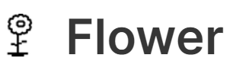



Why do we need an optimization research simulator?
5
Existing frameworks are mainly built
with a focus to be deployed on real-world systems
The entry bar for researchers tends to increase
Frameworks require extensive experience with distributed systems
or assistance from experts on a given framework
In our work, we take one step back and focus on constructing a framework whose primary goal is to provide a useful simulation environment for researchers.
Notes:
Existing frameworks are mainly built with a focus on being deployed on real-world systems,
but we have found missing piece.

Slide 6



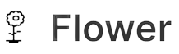


Open-source Federated Learning Frameworks
6
 | TensorFlow Federated (TFF) is a framework for machine learning
 | Framework based on PaddlePaddle from BAIDU Research.
 | Clara Training Framework developed by NVIDIA Research with a focus on the medical domain.
 | Framework targeted to bring Federated Learning into the real world and account for compute heterogeneity, memory constraints, and scaling aspects.
 | A valuable tool for benchmarking and experiments for Federated Learning.
 | PySyft extends PyTorch for private Deep Learning via providing mechanisms based on last advancements in Differential Privacy, Multi-Party Computation, Homomorphic Encryption (HE).
Notes:
“The growing demand for Federated Learning technology hasresulted in several tools and frameworks which have been starting to appear.”
Frameworks for Federated Learning are in active development right now.
According to Peter Kairouz P.~Kairouz Lecture at Stanford from 2020: \url{https://www.youtube.com/watch?v=uZC5yx0POT0}} this is a target number of downloads.
FedML is targeting to be a valuable tool for benchmarking and experiments for Federated Learning. This tool provides a skeleton for implementing standalone and distributed optimization algorithms in Federated Learning. That project uses as communication backends Message Passing Interface(MPI) and Google Remote Procedure Calls (gRPC). The FedML presents event-based communication for distributed implementation, and it does not impose any specific paradigm for standalone implementation. In FedML, one have to provide two separate implementations of an algorithm for Standalone and Distributed mode.
PySyft. It's a great inspirational product of the OpenMined community with 5 000 volunteers that demonstrates that even the security aspect of FL can lead to a very important ecosystem.
Flower - is targeted to bring Federate Learning into the real world and account for compute heterogeneity, memory constraints, and scaling aspects. Flower includes examples, datasets, training pipelines. \texttt{Flower} targets to have the ability to empirical study the increasing of FL training time under compute and network heterogeneity, analyze stability and robustness of large scale experiments. The used communication backend for that system is Google Remote Procedure Calls (gRPC).

Slide 7
Our goals
7
Low Entry Bar/Simplicity
Extensibility
Hardware Utilization
Easy Debugging
Notes:
{Low Entry Bar/ Simplicity}: We aim our tool to be as simple as possible for the user while providing all necessary functionalities.
\item \textit{Extensibility}: It is easy to bring your own algorithm or dataset or extend existing ones. We aim to achieve this by providing universal abstractions with a sufficient level of flexibility to experiment with existing and novel approaches to advance the state-of-the-art.
\item \textit{Hardware Utilisation}: Cross-device FL experiments are usually of much smaller scale comparing to the centralized setting. This is mainly because of limited device capabilities. Running such experiments on GPU can lead to the under-utilisation of available hardware. We aim to resolve this via the ability to parallelise clients' computation.
\item \textit{Easy Debugging}: Debugging multi-process or multi-thread systems is hard. We only require user to provide a single thread implementation which is automatically adjusted to multi-GPU and multi-node setup.

Slide 8

Our goals
8
Low Entry Bar/Simplicity
We aim our tool to be as simple as possible.
GUI interface to launch experiments
Communication with standard TCP/IP transport
Serialization results of experiments
Creating customizable high-quality plots
Extensibility
Hardware Utilization
Easy Debugging
Notes:
{Low Entry Bar/ Simplicity}: We aim our tool to be as simple as possible for the user while providing all necessary functionalities.
\item \textit{Extensibility}: It is easy to bring your own algorithm or dataset or extend existing ones. We aim to achieve this by providing universal abstractions with a sufficient level of flexibility to experiment with existing and novel approaches to advance the state-of-the-art.
\item \textit{Hardware Utilisation}: Cross-device FL experiments are usually of much smaller scale comparing to the centralized setting. This is mainly because of limited device capabilities. Running such experiments on GPU can lead to the under-utilisation of available hardware. We aim to resolve this via the ability to parallelise clients' computation.
\item \textit{Easy Debugging}: Debugging multi-process or multi-thread systems is hard. We only require user to provide a single thread implementation which is automatically adjusted to multi-GPU and multi-node setup.

Slide 9
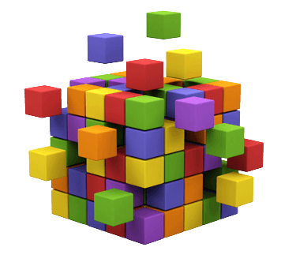
Our goals
9
Low Entry Bar/Simplicity
We aim our tool to be as simple as possible
Universal abstraction for optimization algorithms in FL
Easy way to bring own opt. algorithms, datasets, etc.
Flexibility to experiment with existing and novel approaches to advance the state-of-the-art
We aim to provide universal abstractions
Extensibility
Hardware Utilization
Easy Debugging
Notes:
{Low Entry Bar/ Simplicity}: We aim our tool to be as simple as possible for the user while providing all necessary functionalities.
\item \textit{Extensibility}: It is easy to bring your own algorithm or dataset or extend existing ones. We aim to achieve this by providing universal abstractions with a sufficient level of flexibility to experiment with existing and novel approaches to advance the state-of-the-art.
\item \textit{Hardware Utilisation}: Cross-device FL experiments are usually of much smaller scale comparing to the centralized setting. This is mainly because of limited device capabilities. Running such experiments on GPU can lead to the under-utilisation of available hardware. We aim to resolve this via the ability to parallelise clients' computation.
\item \textit{Easy Debugging}: Debugging multi-process or multi-thread systems is hard. We only require user to provide a single thread implementation which is automatically adjusted to multi-GPU and multi-node setup.

Slide 10
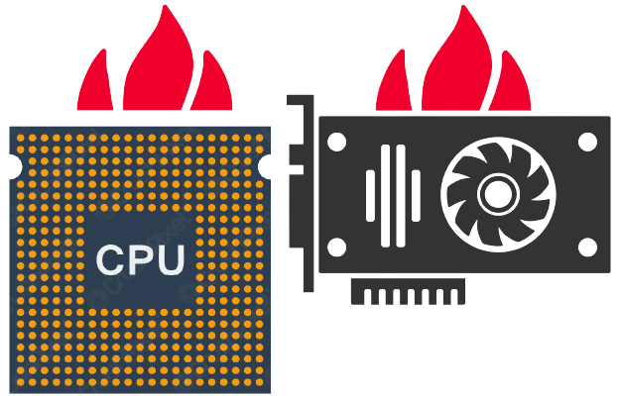
Our goals
10
Low Entry Bar/Simplicity
We aim our tool to be as simple as possible
Extensibility
We aim to provide universal abstractions
We aim to provide extensive runtime configuration
High CPU/GPU utilization under the hood
Ability to include remote compute resources
Provide runtime configuration at a single experiment granularity
Monitoring tools for tracking experimental progress and device utilization
Hardware Utilization
Easy Debugging
Notes:
{Low Entry Bar/ Simplicity}: We aim our tool to be as simple as possible for the user while providing all necessary functionalities.
\item \textit{Extensibility}: It is easy to bring your own algorithm or dataset or extend existing ones. We aim to achieve this by providing universal abstractions with a sufficient level of flexibility to experiment with existing and novel approaches to advance the state-of-the-art.
\item \textit{Hardware Utilisation}: Cross-device FL experiments are usually of much smaller scale comparing to the centralized setting. This is mainly because of limited device capabilities. Running such experiments on GPU can lead to the under-utilisation of available hardware. We aim to resolve this via the ability to parallelise clients' computation.
\item \textit{Easy Debugging}: Debugging multi-process or multi-thread systems is hard. We only require user to provide a single thread implementation which is automatically adjusted to multi-GPU and multi-node setup.

Slide 11

Our goals
11
Low Entry Bar/ Simplicity
We aim to help to debug FL opt. algorithms
The user provides only a single-node implementation
Mapping to multi-GPU/CPU and multi-node setup happens during runtime configuration only
GUI/CUI provides necessary logging information
Means to reproduce the experiments
Extensibility
Hardware Utilization
Easy Debugging
Notes:
{Low Entry Bar/ Simplicity}: We aim our tool to be as simple as possible for the user while providing all necessary functionalities.
\item \textit{Extensibility}: It is easy to bring your own algorithm or dataset or extend existing ones. We aim to achieve this by providing universal abstractions with a sufficient level of flexibility to experiment with existing and novel approaches to advance the state-of-the-art.
\item \textit{Hardware Utilisation}: Cross-device FL experiments are usually of much smaller scale comparing to the centralized setting. This is mainly because of limited device capabilities. Running such experiments on GPU can lead to the under-utilisation of available hardware. We aim to resolve this via the ability to parallelise clients' computation.
\item \textit{Easy Debugging}: Debugging multi-process or multi-thread systems is hard. We only require user to provide a single thread implementation which is automatically adjusted to multi-GPU and multi-node setup.

Slide 12
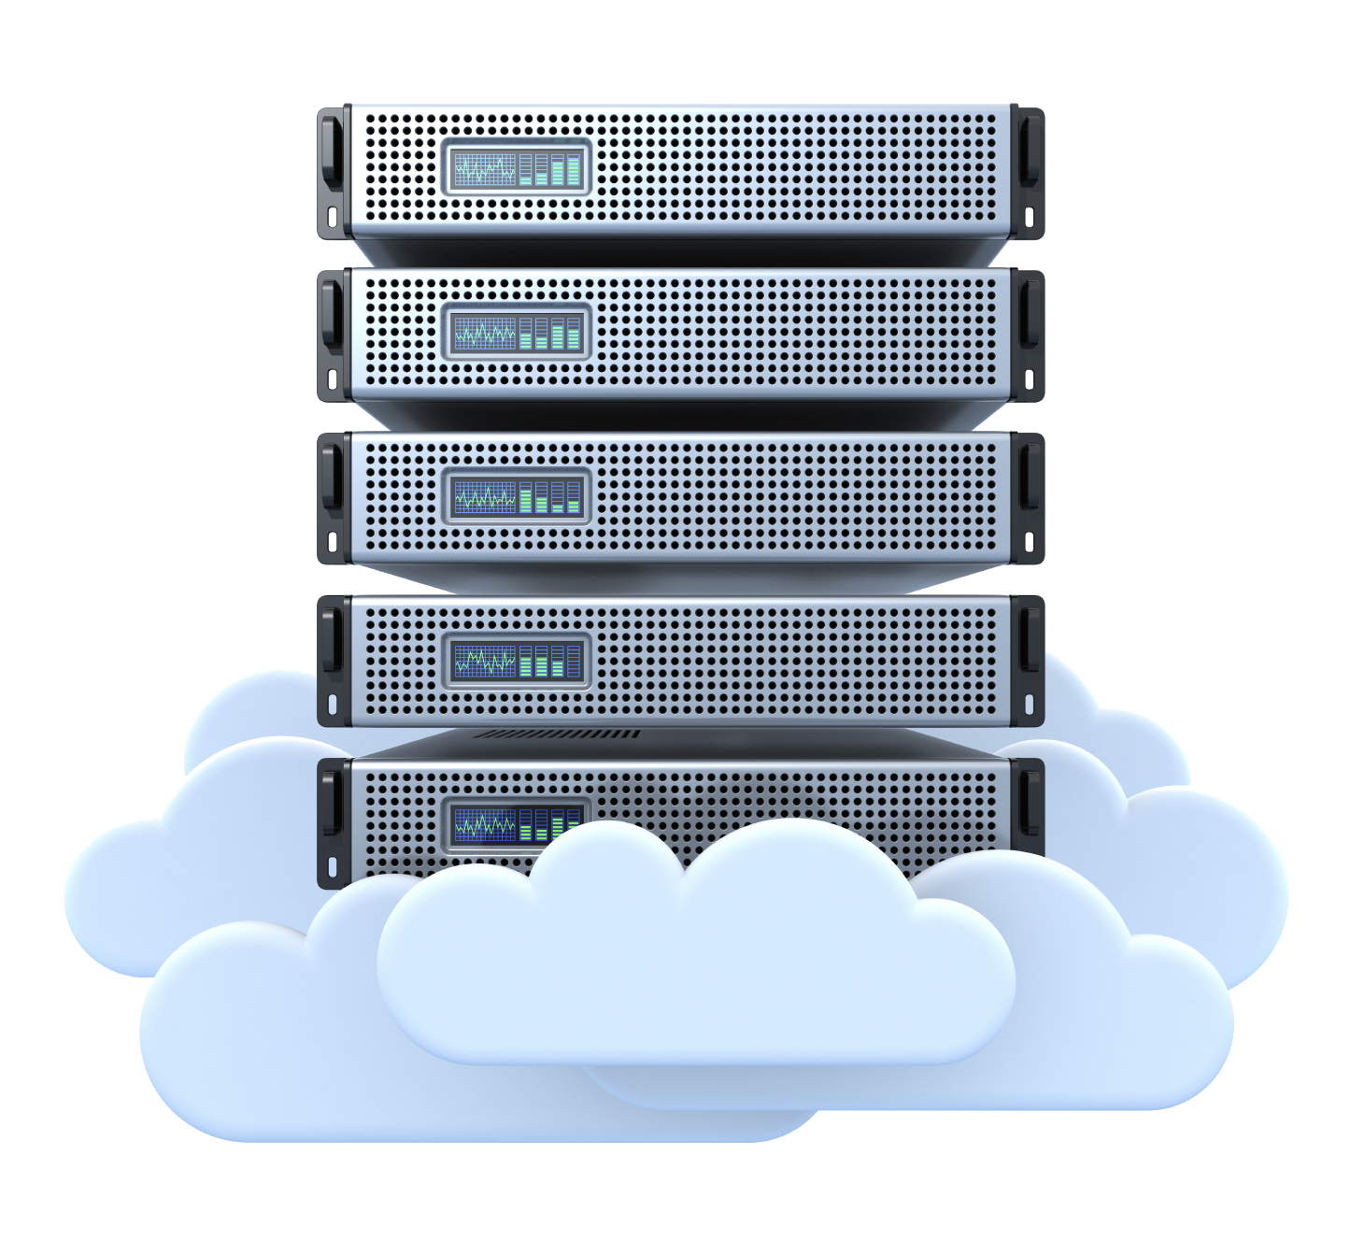




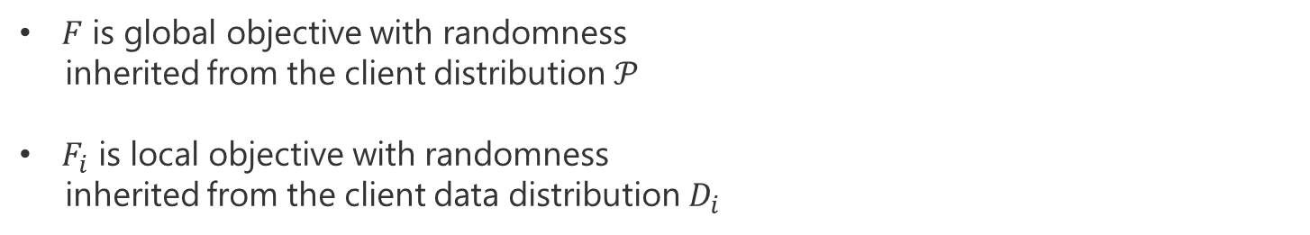
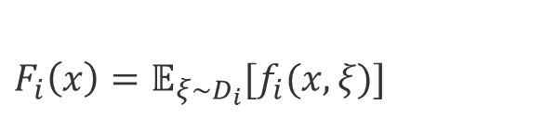
Federated Learning Objective
12
$${min.}_{x}^{}F\left(x\right)≜ 𝔼_{i\sim 𝒫}\left[F_{i}\left(x\right)\right]$$
$F_{i}\left(x\right)=𝔼_{ξ\sim D_{i}}[f_{i}(x,ξ)]$
$F$ is global objective with randomness
inherited from the client distribution $𝒫$
$F_{i}$ is local objective with randomness
inherited from the client data distribution $D_{i}$
. . .
Notes:
In the case of the finite number of clients and local data points - global and local objective losses can be written in form of approximate solution

Slide 13
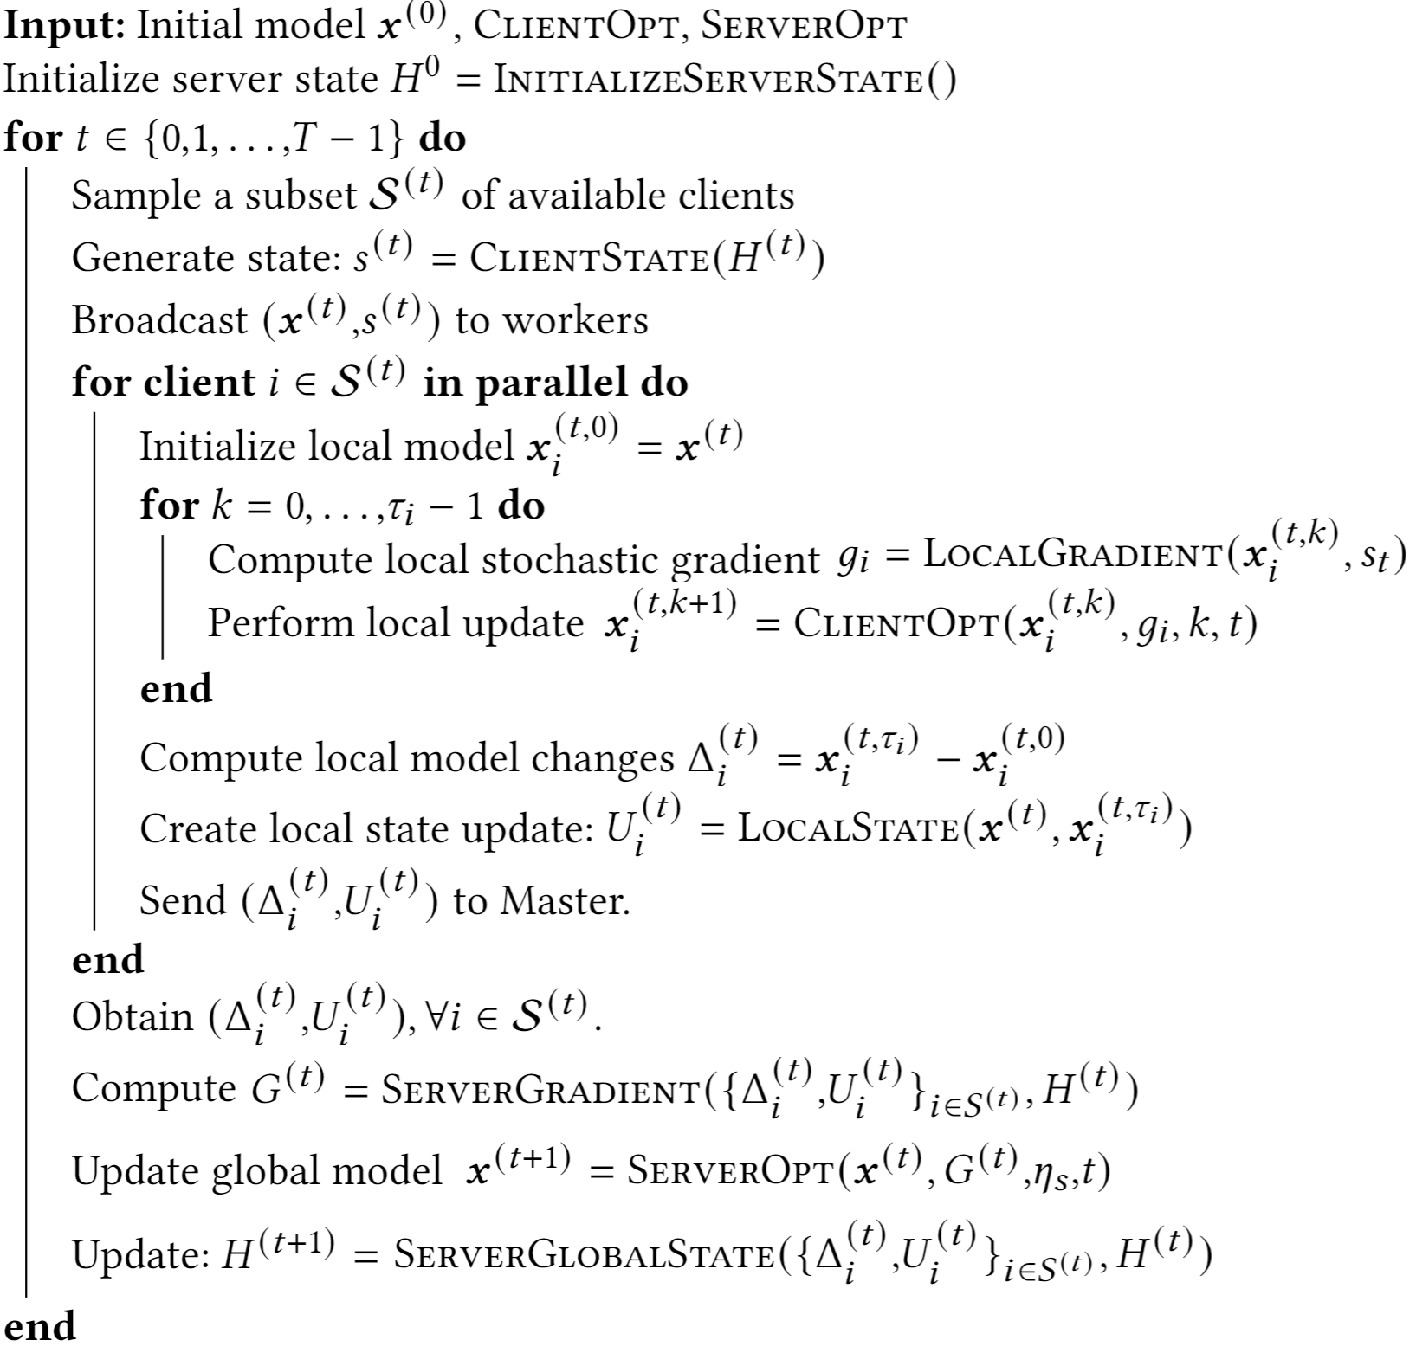


Generalized Federated Averaging
FL_PyTorch
Written in Python language only
Build upon PyTorch abstractions
Notes:
This algorithm captures all opt. methods from literature.
Make it wider
Remove first line from Algorithm, node needed.

Slide 14
Generalized Federated Averaging
InitializeServerState
This method returns a dictionary that initializes the server state. The method constructs and initializes the model.
Notes:
This algorithm captures all opt. methods from literature.
Make it wider
Remove first line from Algorithm, node needed.

Slide 15
Generalized Federated Averaging
ClientState
By our design client state is stateless. The client state is instantiated at the beginning of each round for each of the selected clients.
If you need a client state you may initialize it from the server state.
Notes:
This algorithm captures all opt. methods from literature.
Make it wider
Remove first line from Algorithm, node needed.

Slide 16
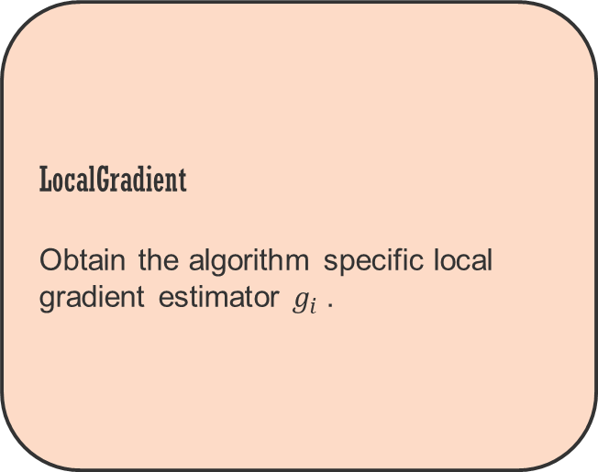
Generalized Federated Averaging
LocalGradient
Obtain the algorithm specific local gradient estimator $g_{i}$.
Notes:
This algorithm captures all opt. methods from literature.
Make it wider
Remove first line from Algorithm, node needed.

Slide 17
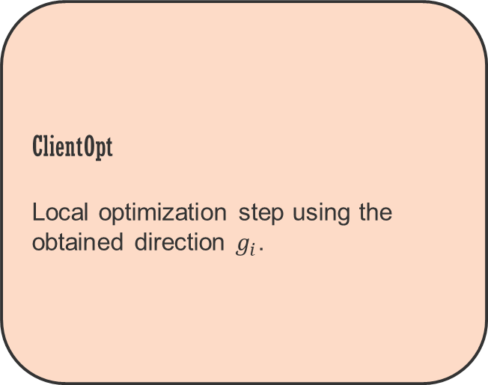
Generalized Federated Averaging
ClientOpt
Local optimization step using the obtained direction $g_{i}$.
Notes:
This algorithm captures all opt. methods from literature.
Make it wider
Remove first line from Algorithm, node needed.

Slide 18
Generalized Federated Averaging
LocalState
Collect all the local states that are sent to the master jointly with the local update.
Notes:
This algorithm captures all opt. methods from literature.
Make it wider
Remove first line from Algorithm, node needed.

Slide 19
Generalized Federated Averaging
ServerGradient
The estimator of the global direction to be used for the global model update.
Notes:
This algorithm captures all opt. methods from literature.
Make it wider
Remove first line from Algorithm, node needed.

Slide 20
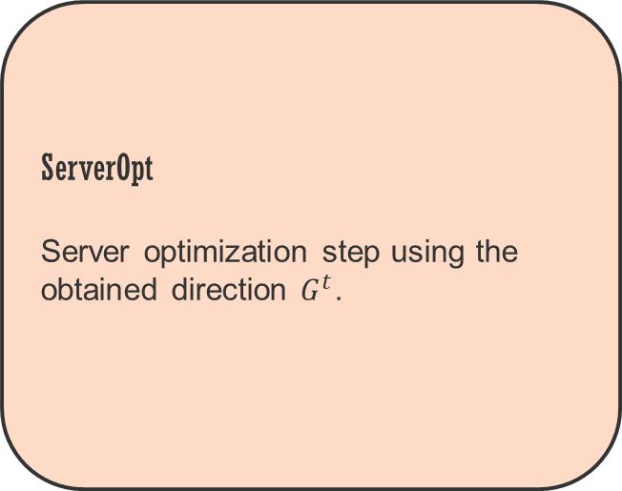
Generalized Federated Averaging
ServerOpt
Server optimization step using the obtained direction $G^{t}$.
Notes:
This algorithm captures all opt. methods from literature.
Make it wider
Remove first line from Algorithm, node needed.

Slide 21
Generalized Federated Averaging
ServerGlobalState
The global server state update
Notes:
This algorithm captures all opt. methods from literature.
Make it wider
Remove first line from Algorithm, node needed.

Slide 22
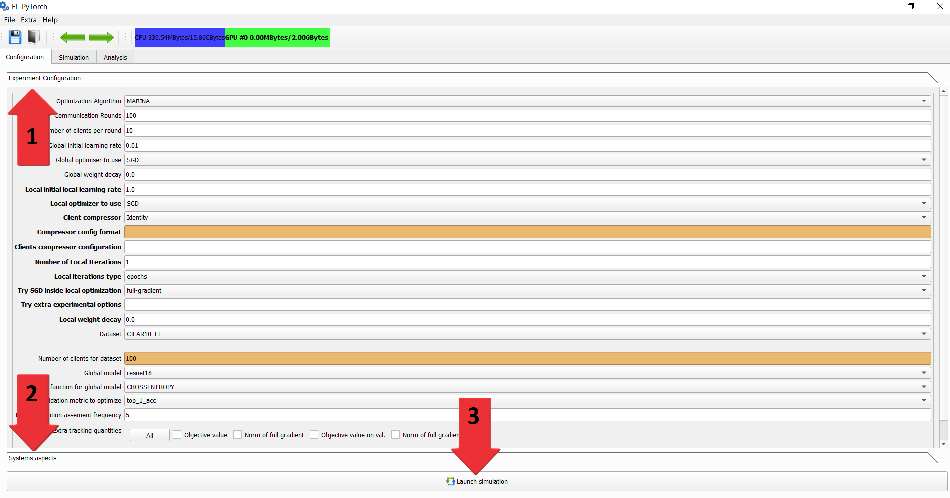
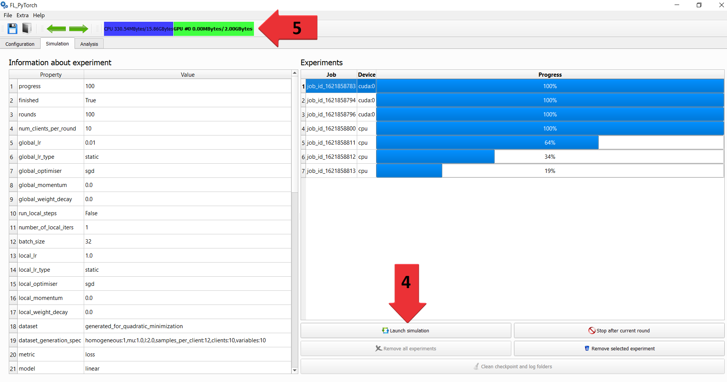
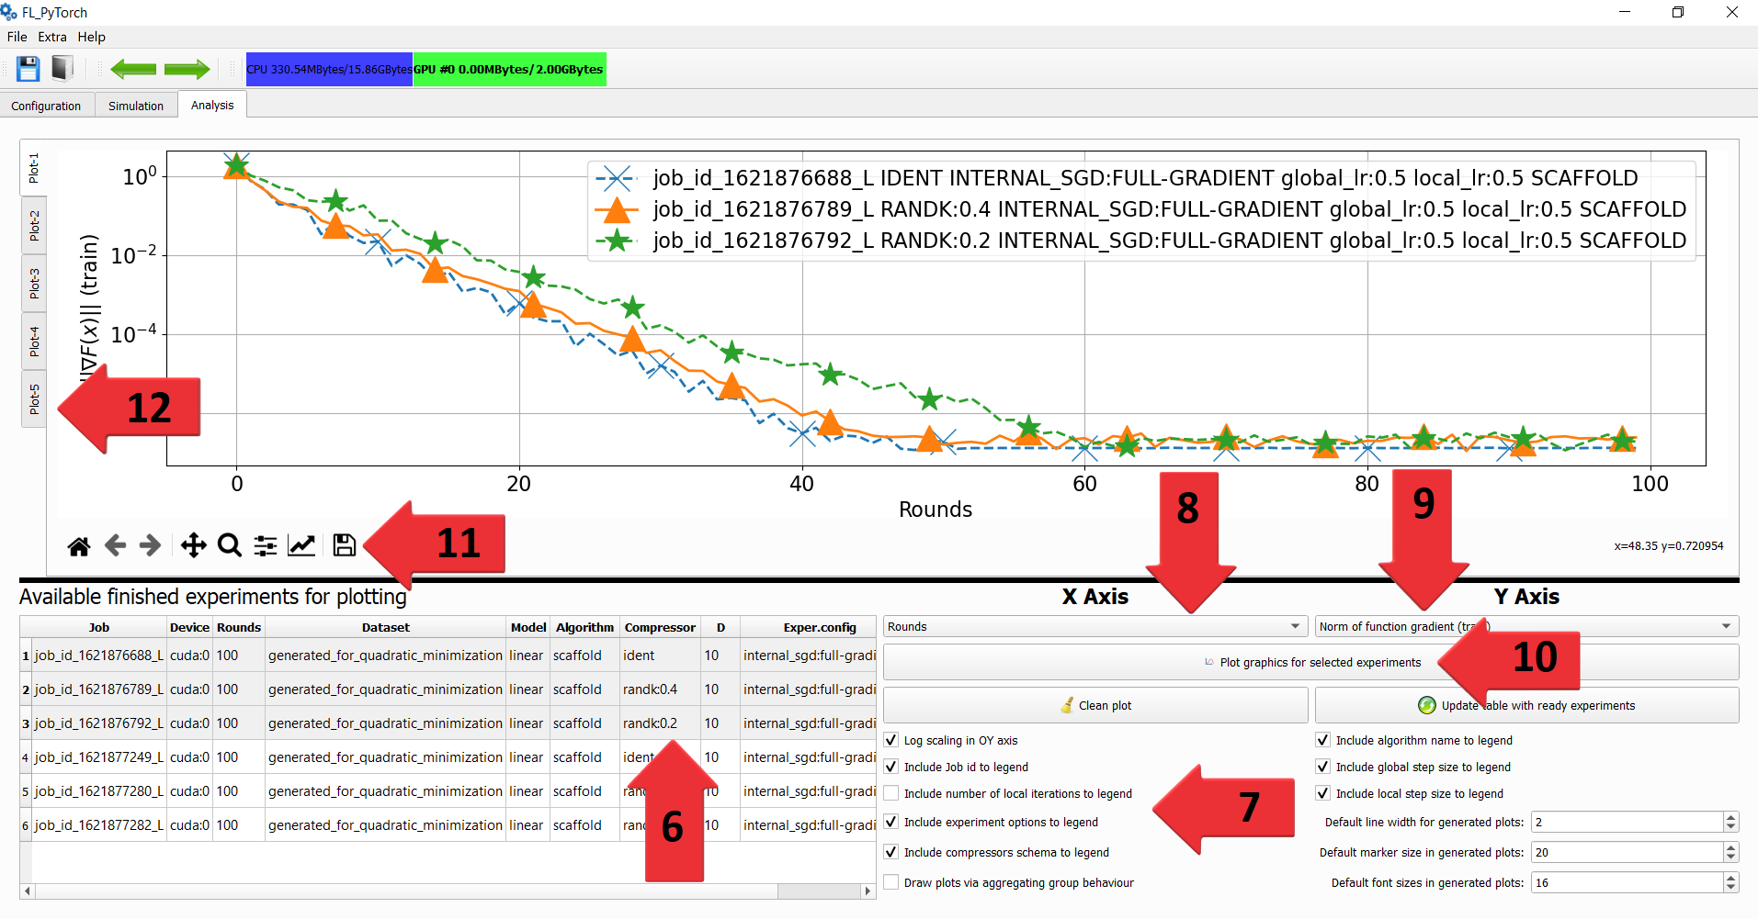
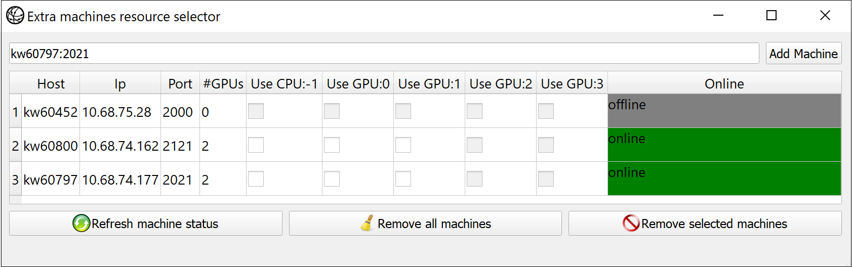
FL Optimization Research Simulator: UI
Graphical UI
Notes:
The GUI interface is used to:
Launch, Save, Analyze results of experiments
Specify compute resources in a nice form
Organize work under experiment

Slide 23
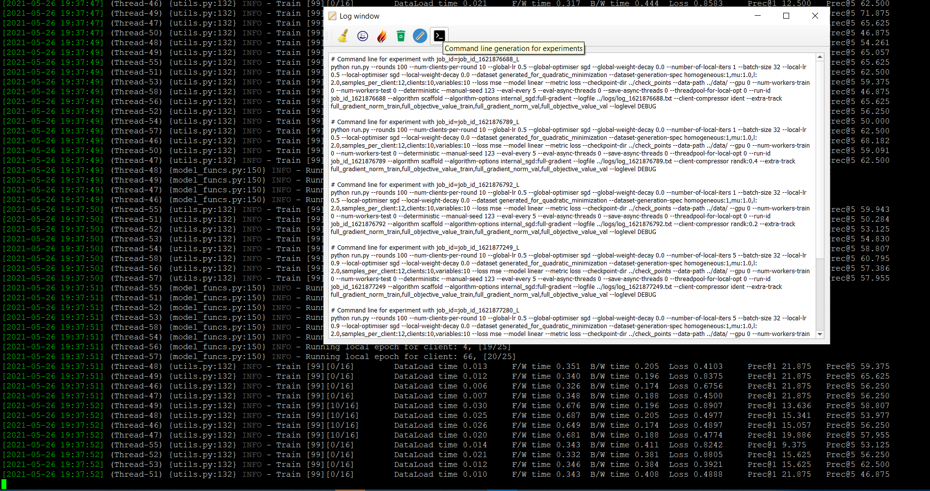
FL Optimization Research Simulator: UI
Console UI
Notes:
The CLI interface is used to:
Instantiate remote workers
Launch simulation with command line
Execute batch of simulation with generated command line

Slide 24
FL Optimization Research Simulator
Graphical UI
Console UI
Configuration

Slide 25
FL Optimization Research Simulator
Graphical UI
Console UI
Server Optimizer: number of communication rounds, the number of sampled clients etc.
Local Optimizer: number of local epochs or local iterations; batch sizes, etc.
Model and Data: models’ and datasets’ names.
System Setup: random seeds, local/remote compute devices, thread pool sizes, etc.

Slide 26
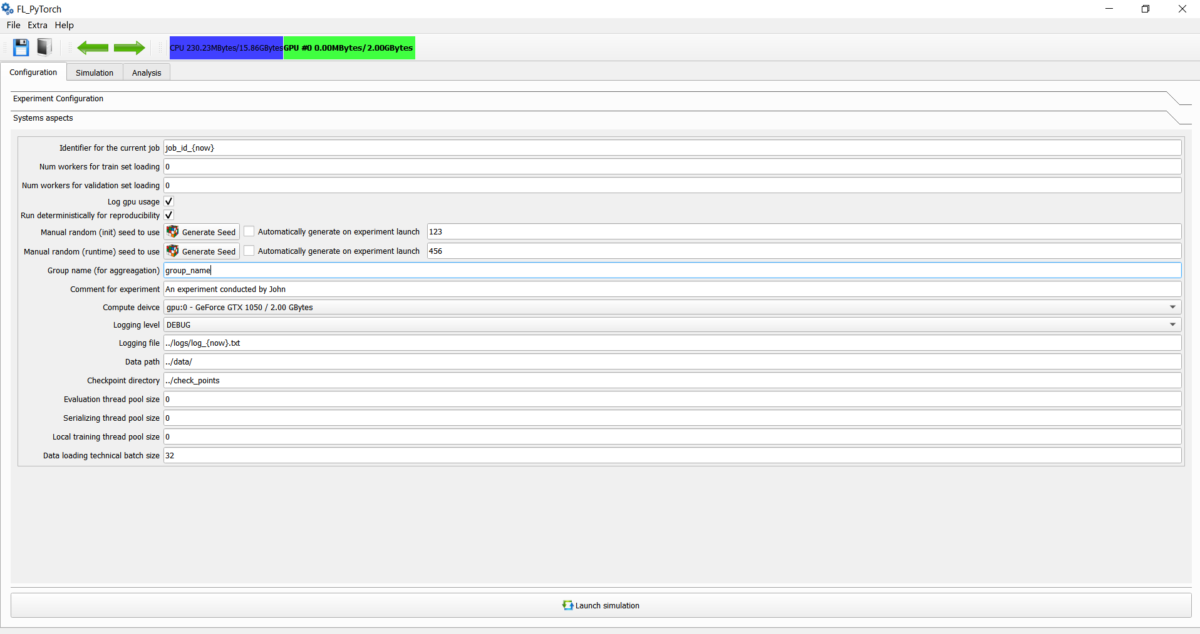
FL Optimization Research Simulator
Graphical UI
Console UI
Server Optimizer: the number of communication rounds, the number of sampled clients etc.
Local Optimizer: the number of local epochs or local iterations; batch size, etc.
Model and Data: model's and dataset's names.
System Setup: random seeds, target local/remote compute devices, thread pool sizes, etc.

Slide 27
FL Optimization Research Simulator
Graphical UI
Console UI
Configuration: command line or actions in GUI
Launch experiments: locally or remotely, in specified target devices
Computation backend is a PyTorch.
During the simulation, the selected local CPUs/GPUs are accessed in a parallel way.
There is a possibility to use remote CPUs/GPUs with a TCP transport layer.
Target devices are server and desktop stations running on Linux, macOS, or Windows OS.

Slide 28
FL Optimization Research Simulator
Graphical UI
Console UI
Configuration: command line or actions in GUI
Launch experiments: locally or remotely, in specified target devices
Computation backend: PyTorch.
During the simulation the selected local CPUs/GPUs are accessed in a parallel way
There is a possibility to use remote CPUs/GPUs, if remote devices have a TCP transport layer
Target devices: server and desktop stations running on Linux, macOS, or Windows OS.

Slide 29
FL Optimization Research Simulator
Graphical UI
Console UI
Configuration: command line or actions in GUI
Launch experiments: locally or remotely, in specified target devices
Quantities to track: number of communication rounds, loss, accuracy, the norm of computed gradient, the norm of the full objective gradient, function values, number of gradient oracle calls, number of communicated bits.
Visualize the progress of their experiments in an interactive fashion.
Monitor CPU/GPU utilization.
Ability to monitor progress and current device load

Slide 30
FL Optimization Research Simulator
Graphical UI
Console UI
Configuration: command line or actions in GUI
Launch experiments: locally or remotely, in specified target devices
Ability to monitor progress and current device load
Quantities to track: number of communication rounds, loss, accuracy, the norm of computed gradient, the norm of the full objective gradient, function values, number of gradient oracle calls, number of communicated bits.
Visualize the progress of their experiments in an interactive fashion.
Monitor CPU/GPU utilization.

Slide 31
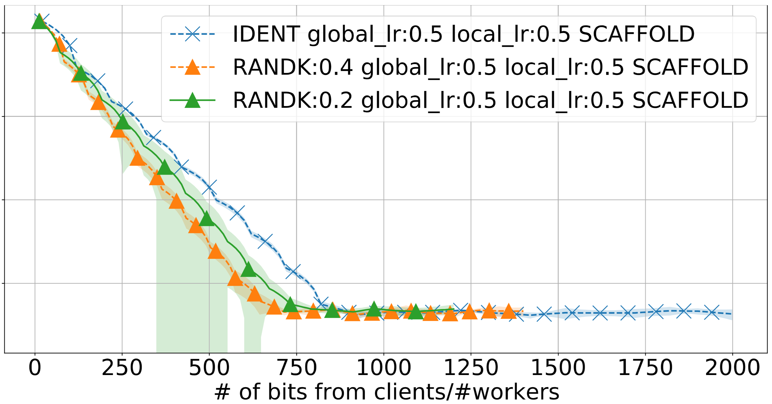
FL Optimization Research Simulator
Graphical UI
Console UI
Configuration: command line or actions in GUI
Launch experiments: locally or remotely, in specified target devices
Monitoring tools per experiment progress, CPU/GPU load, current experiments
Save, Load, Analyze results of experiments for future analysis
Visualize their experiments progress in an interactive fashion in the tool offline
Export information to online tool wanb.ai
Save and load experimental results
Recover arguments passed via the GUI tool in the command line format

Slide 32
FL Optimization Research Simulator
Graphical UI
Console UI
Configuration: command line or actions in GUI
…
Save, Load, Analyze results of experiments for future analysis
Visualize their experiments progress in an interactive fashion in the tool offline
Export information to online tool wanb.ai
Save and load experimental results
Recover arguments passed via the GUI tool in the command line format
Select axis and styles of 2d graphics and plot experimental results

Slide 33
FL Optimization Research Simulator
State-of-the-arts Opt.Algorithms
Distributed Compressed Gradient Descent
FedAVG
SCAFFOLD
FedProx
DIANA
MARINA
Communication reduction mechanisms
Local updates
Limiting the participating clients per round
Compressors
Identical compressor
Lazy or Bernoulli compressor
Rand-K
Natural compressor
Standard dithering
Natural Dithering
Models and Datasets
ResNet(18,34,50,101,152), VGG(11,13,16,19)
WideResNets (28_2, 28_4, 28_8)
Support for simple controllable
Quadratic functions as toy problems
Standard FL datasets
Synthetically generated
Notes:
Our general level of abstraction introduced in Algorithm~\ref{algo:generalized_fedavg} allows for a sufficient level of freedom to implement
standard and also more exotic FL optimization algorithms.
In TUTORIAL we provide:
A detailed description of how to add our own functionality in any of these aspects
How to integrate into GUI
Models and datasets.

Slide 34
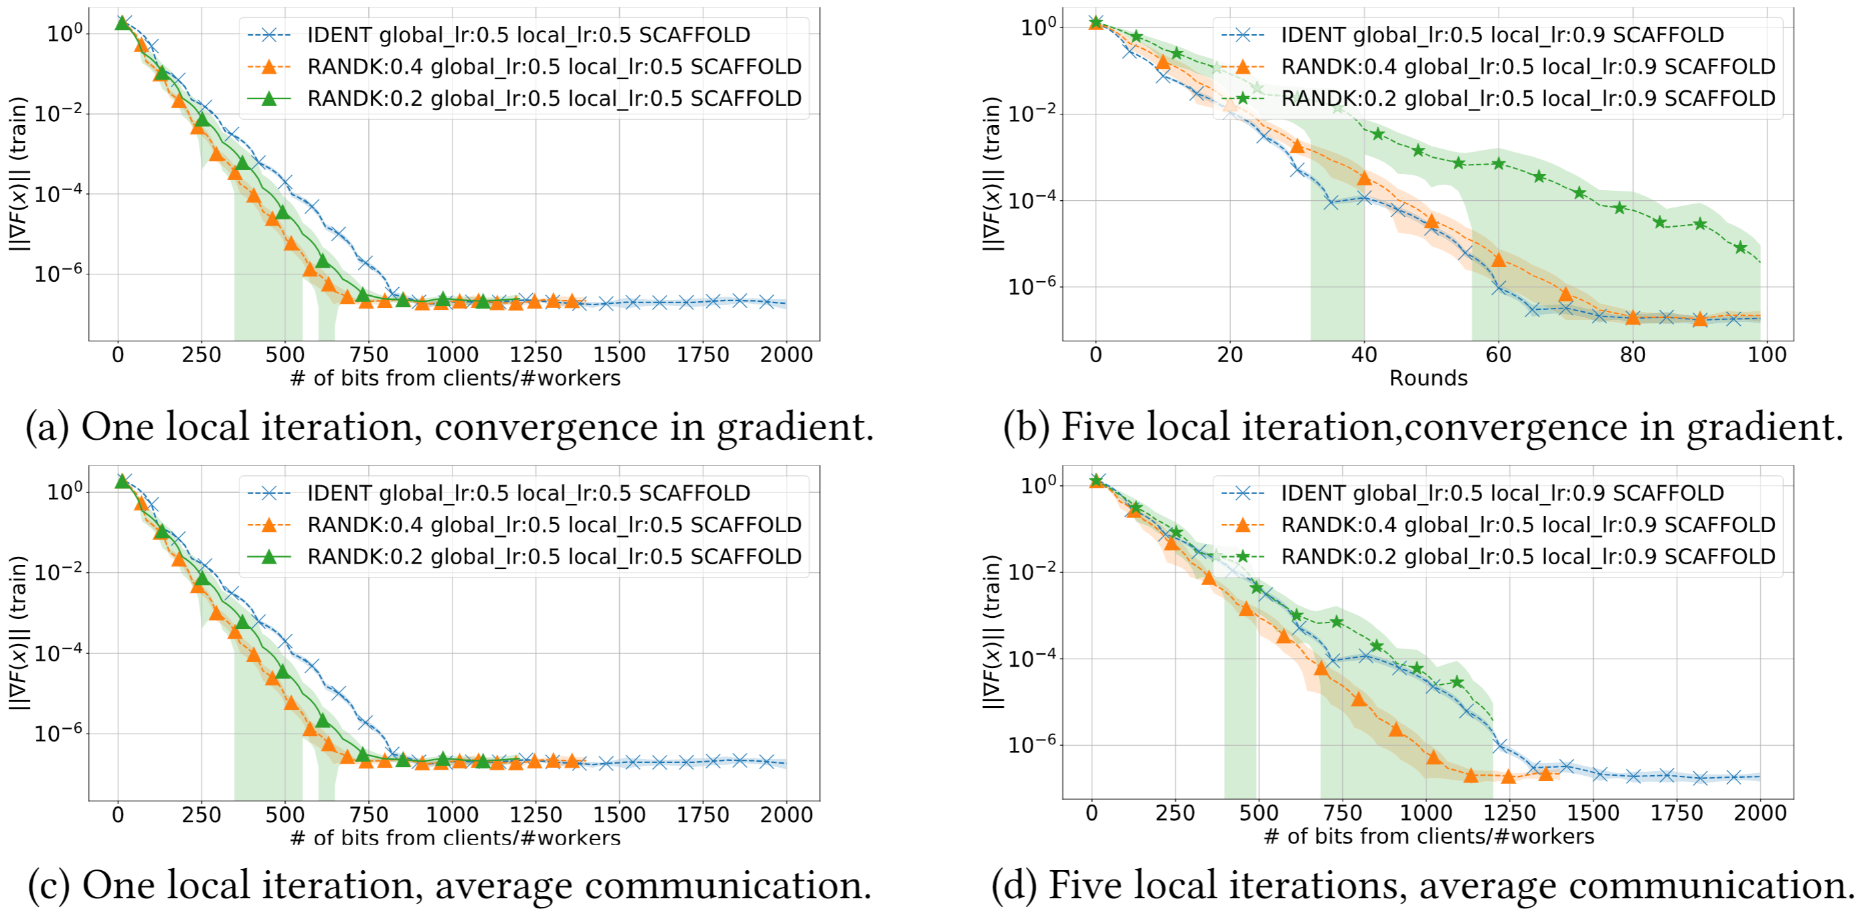
Experiment example
In the paper, we provide several experiments to showcase potential use cases of FL_PyTorch
We used our framework to analyze whether SCAFFOLD can work with compression, i.e. whether messages from clients in the SCAFFOLD algorithm can be compressed.
In synthetized quadratic optimization problem experiments demonstrated that it might be worthwhile to consider an extension of SCAFFOLD by adding compression.
Notes:
Our general level of abstraction introduced in Algorithm~\ref{algo:generalized_fedavg} allows for a sufficient level of freedom to implement
standard and also more exotic FL optimization algorithms.
In TUTORIAL we provide:
A detailed description of how to add our own functionality in any of these aspects
How to integrate into GUI
Models and datasets.

Slide 35

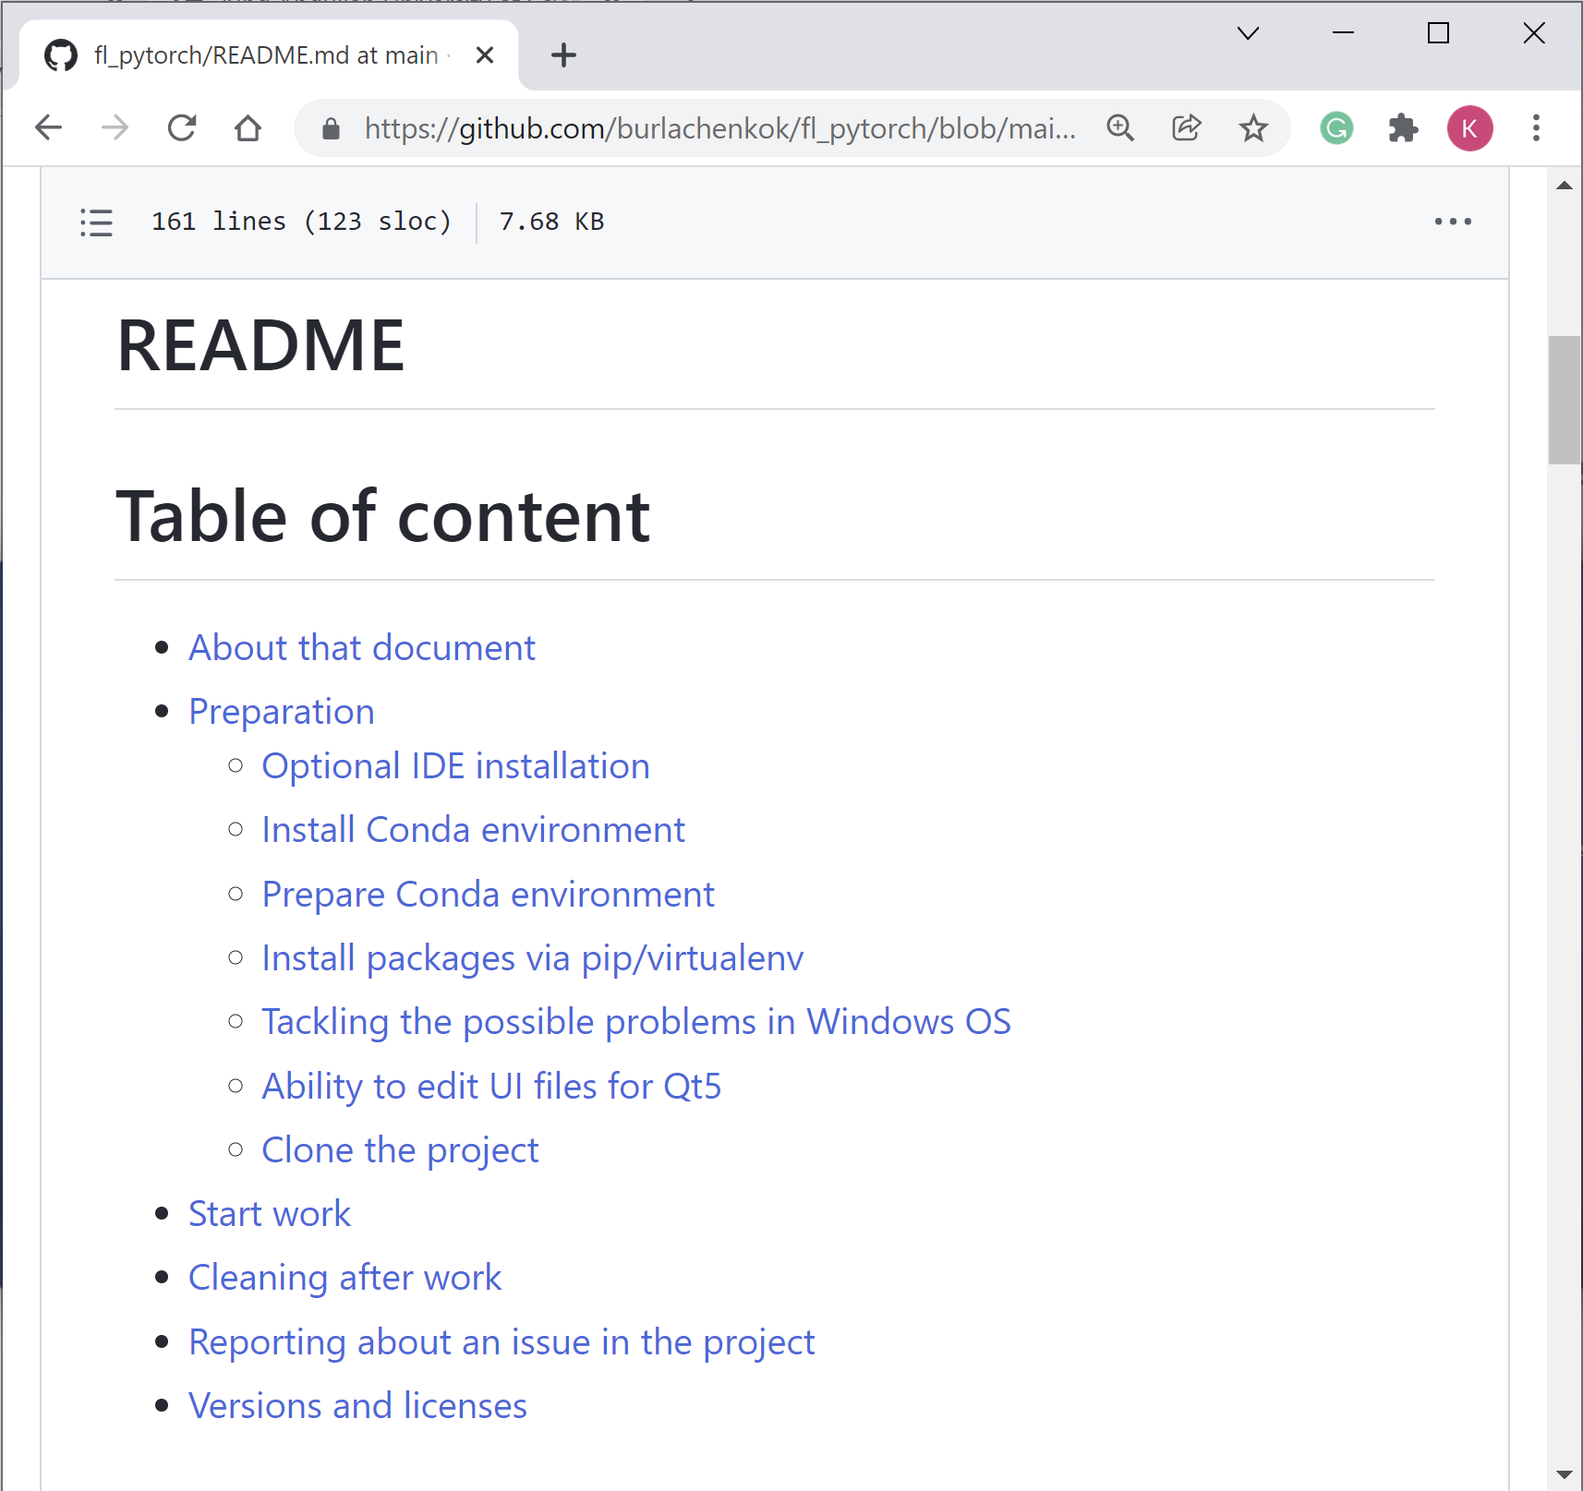
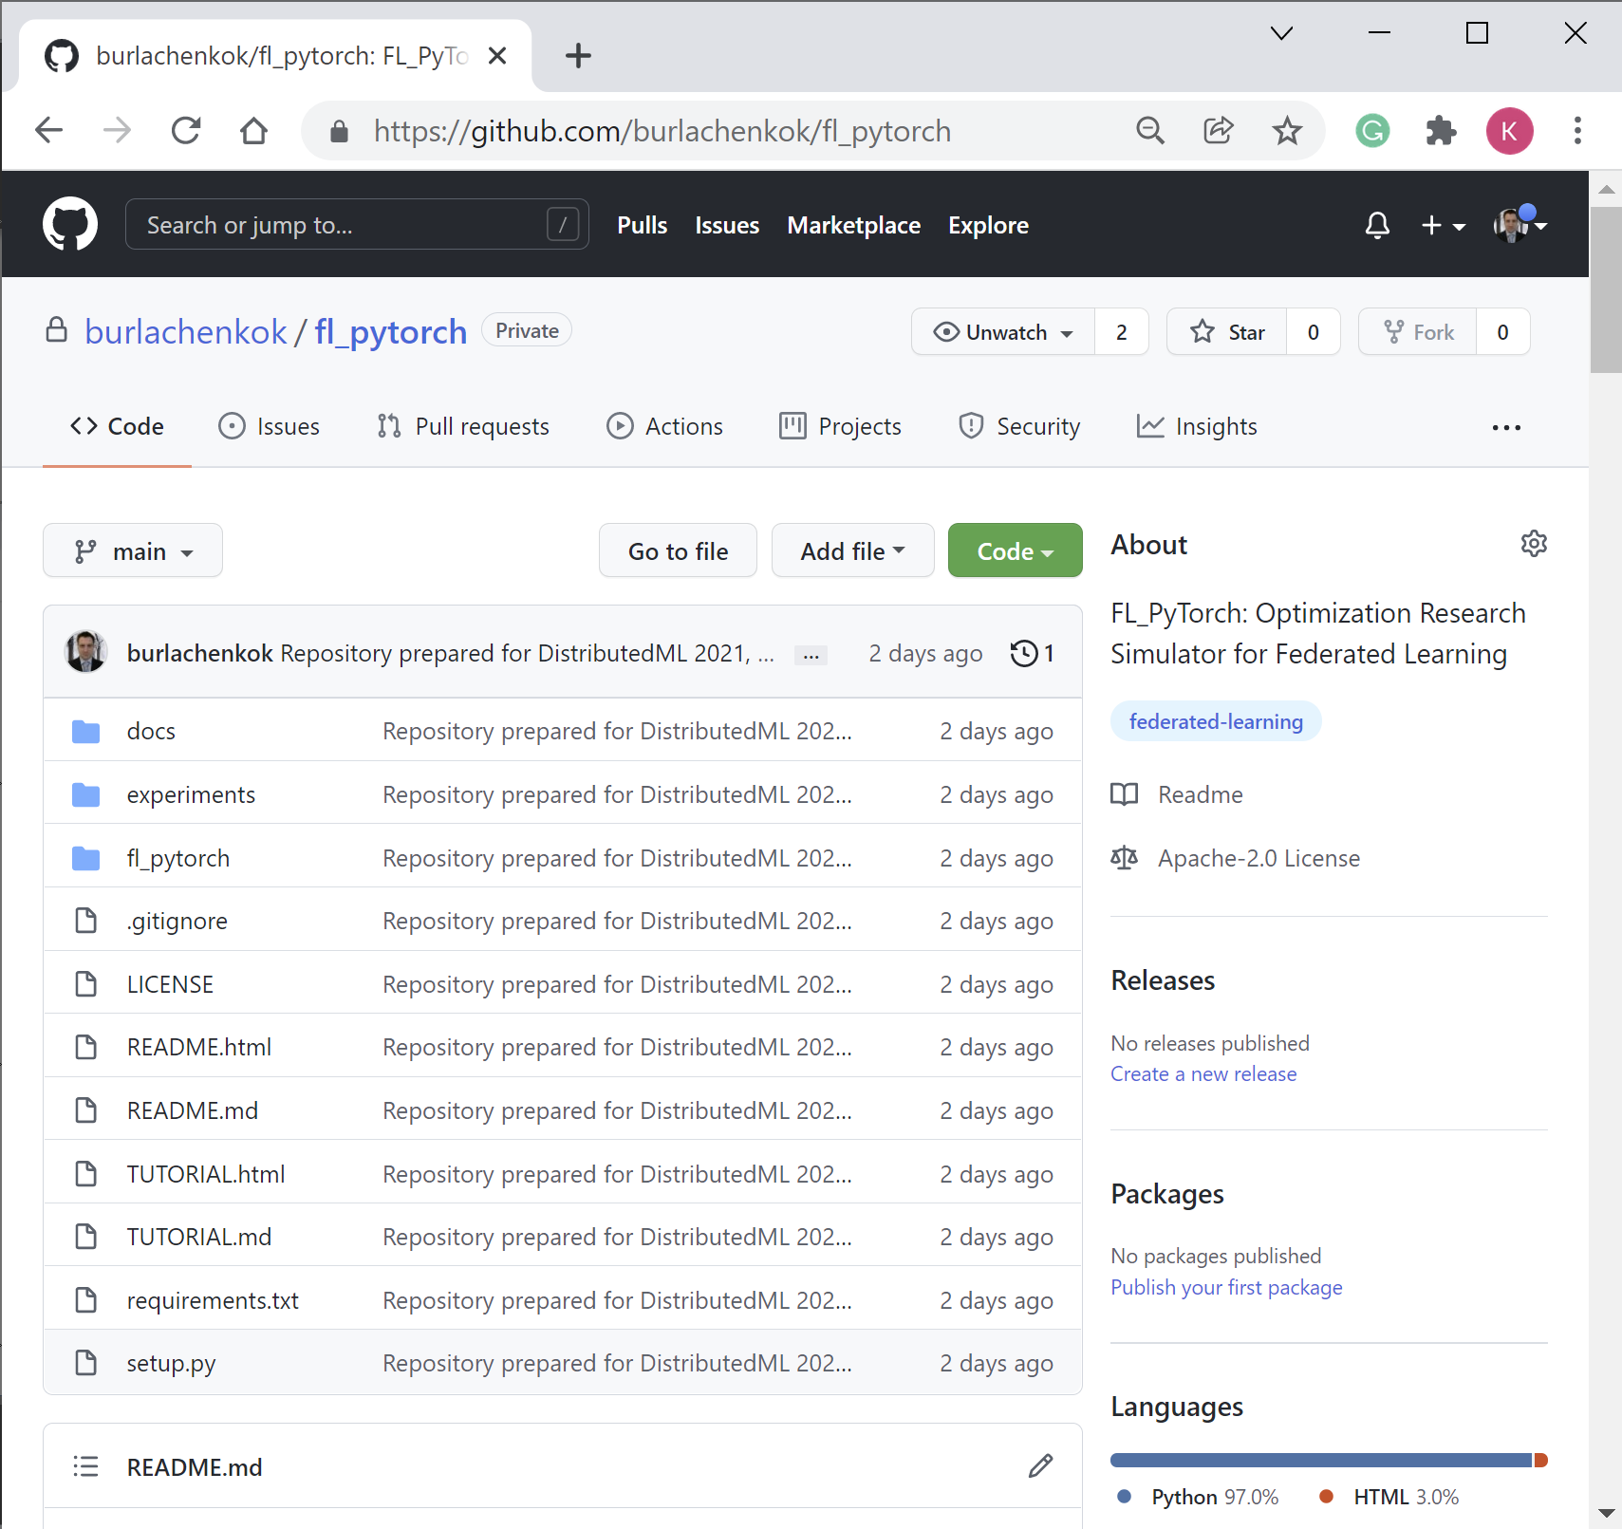
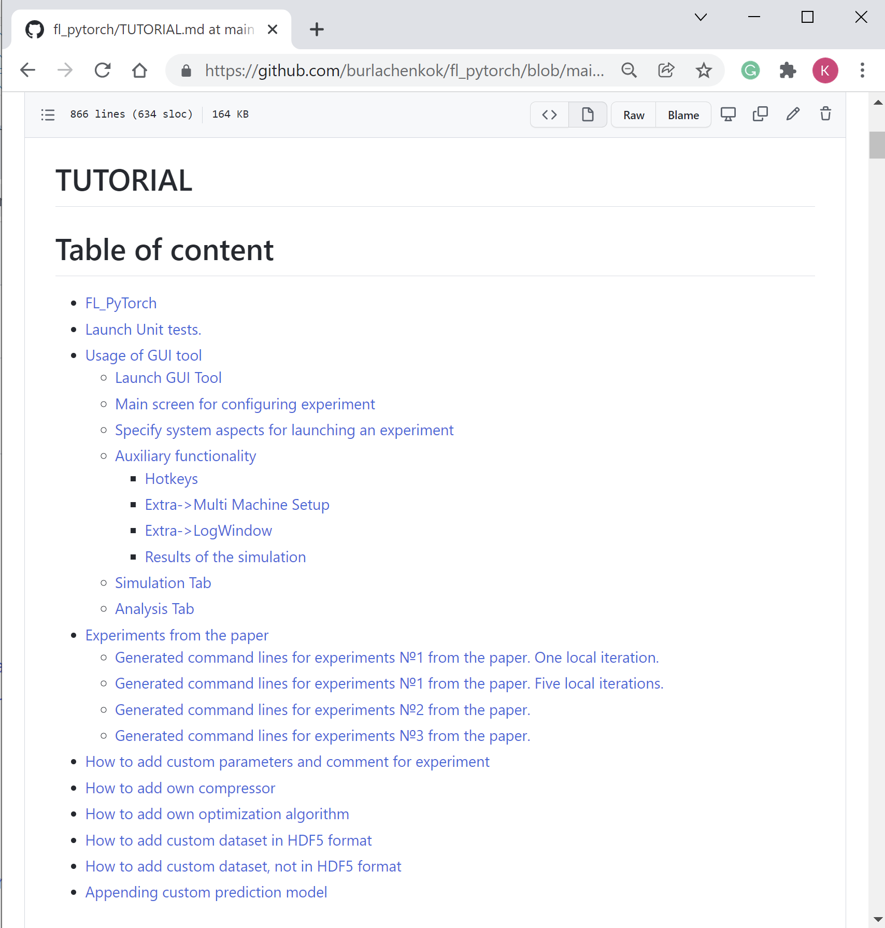
More Information
Please take a look at the original paper for motivation and goals.
Git repository: https://github.com/burlachenkok/flpytorch.git
Sources of information: paper, sources, readme, tutorial, documentation, unit tests.
Notes:
In this work, we have introduced FL_PyTorch, an efficient FL simulator based on PyTorch that enables FL researchers to experiment with optimization algorithms to advance current state-of-the-art(SOTA).FL_PyTorchis an easy to use tool that supports SOTAFL algorithms and the most used image classification FL datasets

Slide 36
Thank you for your attention
Konstantin Burlachenko
PhD student KAUST
konstantin.burlachenko@kaust.edu.sa
https://burlachenkok.github.io/
FL_PyTorch: Optimization Research Simulator for Federated Learning
Notes:
Gentle Introduction into Federated Learning. What is, why it is interesting.
Define in easy way. (Talk about Examples) (30 seconds)

Slide 37
Extra Slides

Slide 38
Speeds of some buses
Memory Transferring direction within a single node (PC) | Approximate typical Speed
CPU <-> System DDR Memory | 51 200 MBytes/sec(DDR5)
GPU core <-> GPU DDR Memory | 128 000 MBytes/sec (GDDR6)
GPU DDR <-> PCI-E <-> System DDR Memory | 4 000 MBytes / sec (PCI-E v5, 1 lane)
SATA 3x (HDD) | 600 MBytes / sec (SATA 3.x, 6Gb/sec)
USB 3.0 (External storage) | 600 MBytes / sec
GPU <-> GPU (NVLink) | 50 000 Mbytes/sec
GPU <-> GPU (NVLink via NVSwitch inside DGX-2) | 50 000 Mbytes/sec
Memory Transferring direction within a mult. nodes (PCs) | Typical Speed
Fast Ethernet | 12.5 MBytes/sec
Gigabit Ethernet | 125 MBytes/sec
InfiniBand HDR | 6250 Mbytes/sec
InfiniBand Melanox | 25 000 Mbytes/sec

Slide 39
NVIDIA GPU Software Compute Ecosystem
Application from specific domains
Consumer Applications (recommendation systems) |  |  |  |  |  | Industrial Applications (Manufacture, Finance) |  |  |  |  |  | Scientific Applications (Molecular Simulation, Seismatics, etc.)
Frameworks and Application
MXNET | Chainer |  | PyTorch |  |  | TensorFlow |  | RAPIDS |  | Caffe | OCTAVE | Matlab | FFMPEG
NVIDIA SDK AND LIBRARIES
ML LIBRAIRES |  | DL LIBRARIES |  |  |  |  |  |  |  |  |  | HPC LIBRARIES
cuDF | cuML | cuGRAPH |  |  | cuBLAS |  | cuDNN |  | TensorRT |  | cuTLASS | cuBLAS, cuSPARSE |  | cuFFT |  | etc.
CUDA Programming Model (including Developer Tools, Runtime, Compilers)
GPU REAL AND VIRTUAL HARDWARE
 | GPUs |  |  | DGX Station |  |  |  |  |  | Virtual GPU

Slide 40
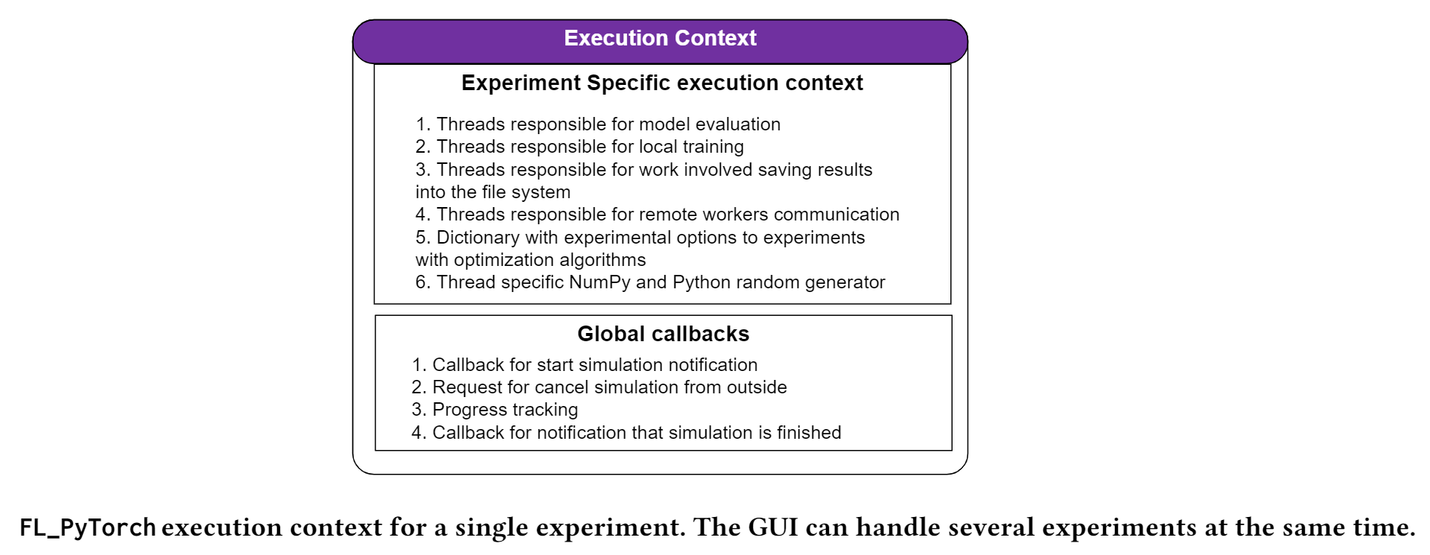

Slide 41
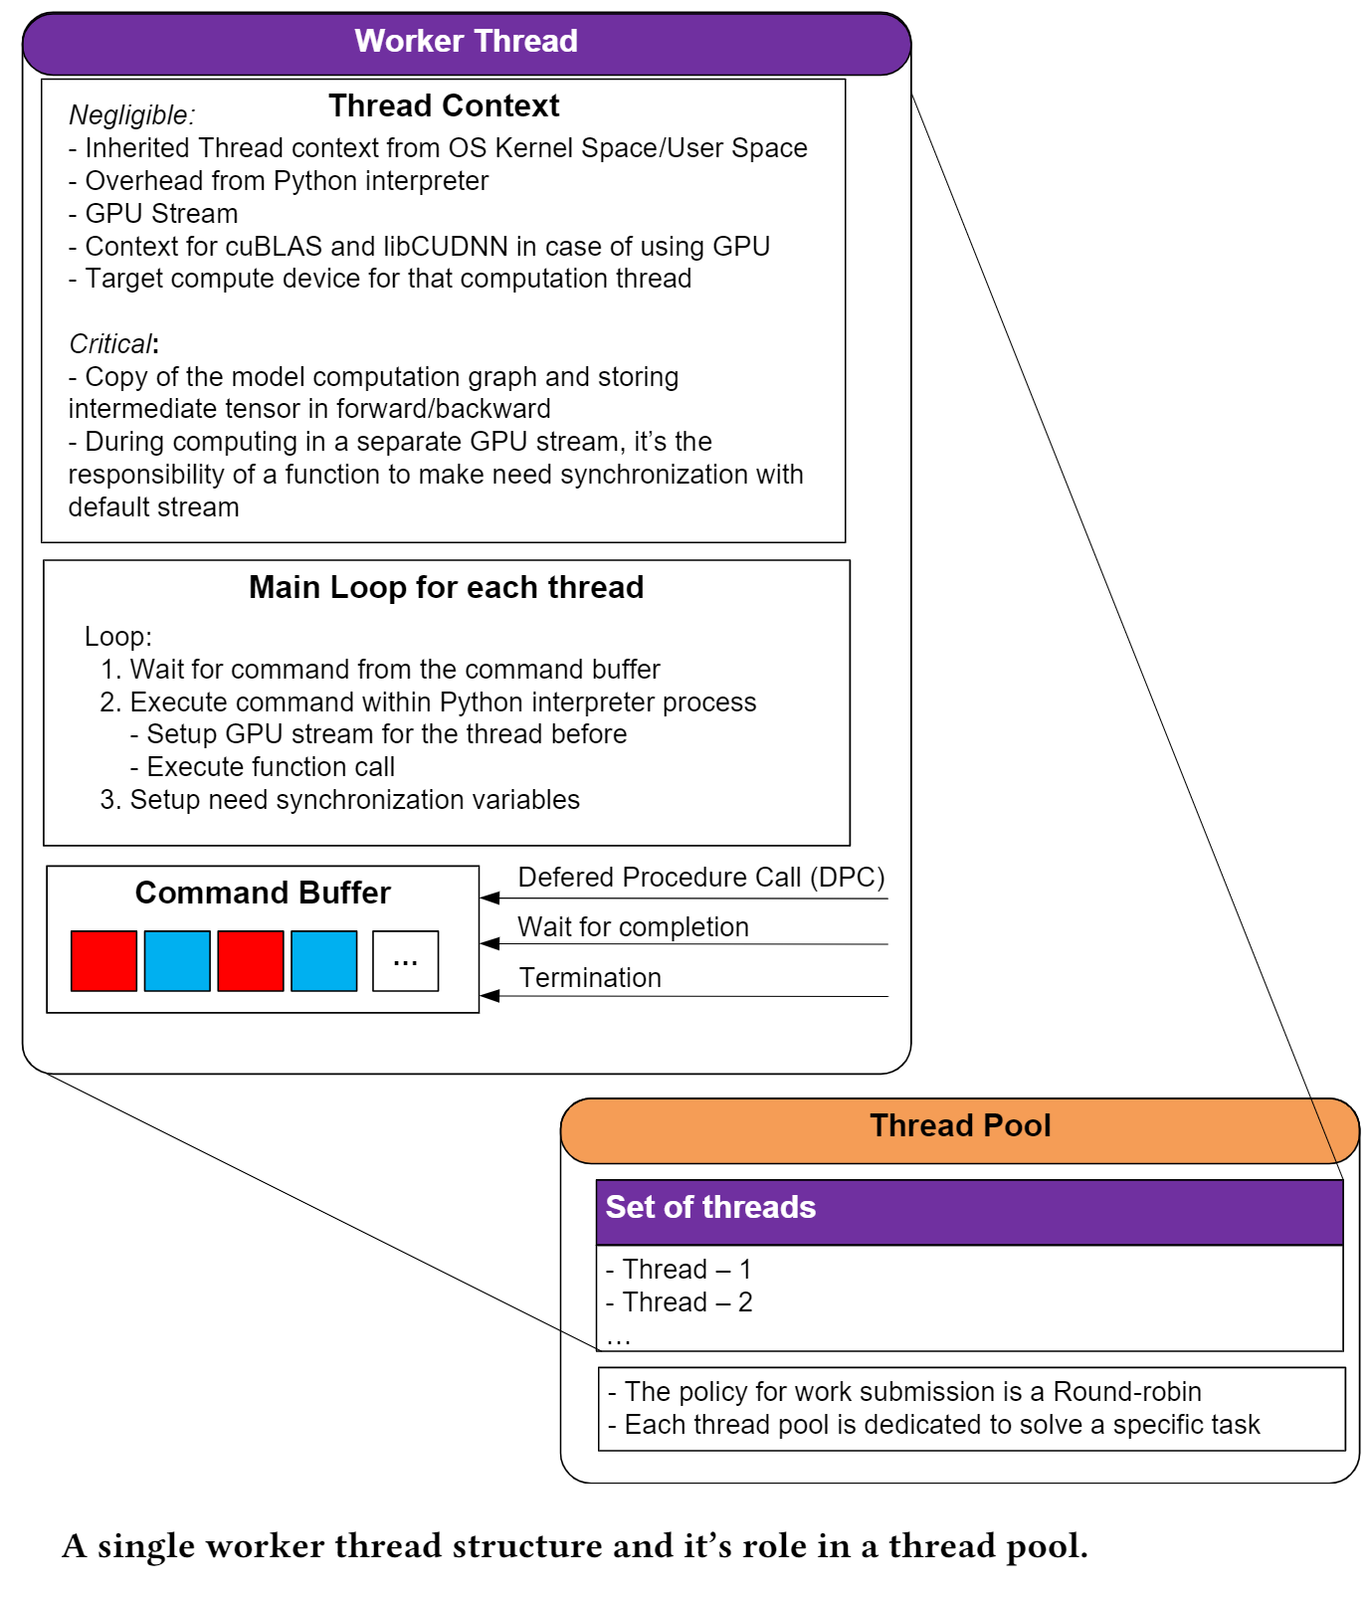

Slide 42
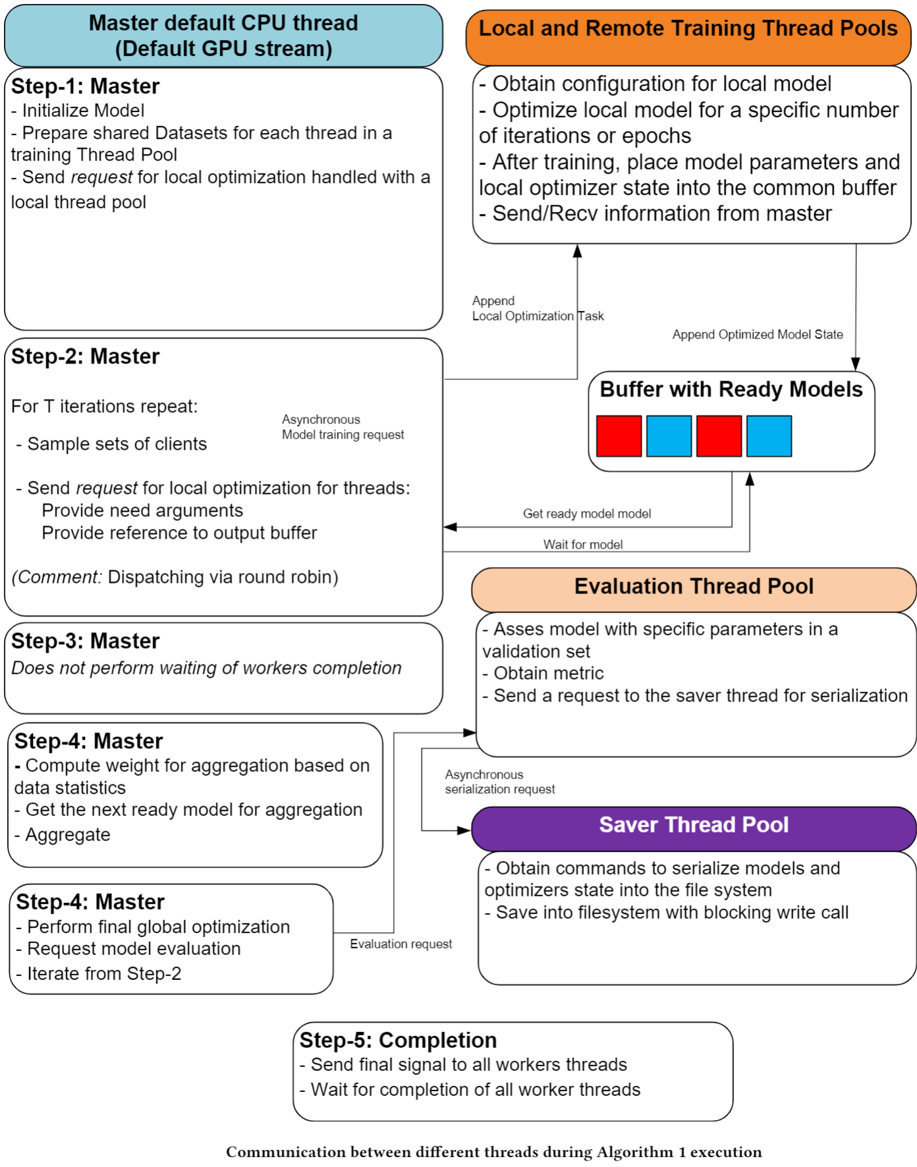

Slide 43
